Slide 1
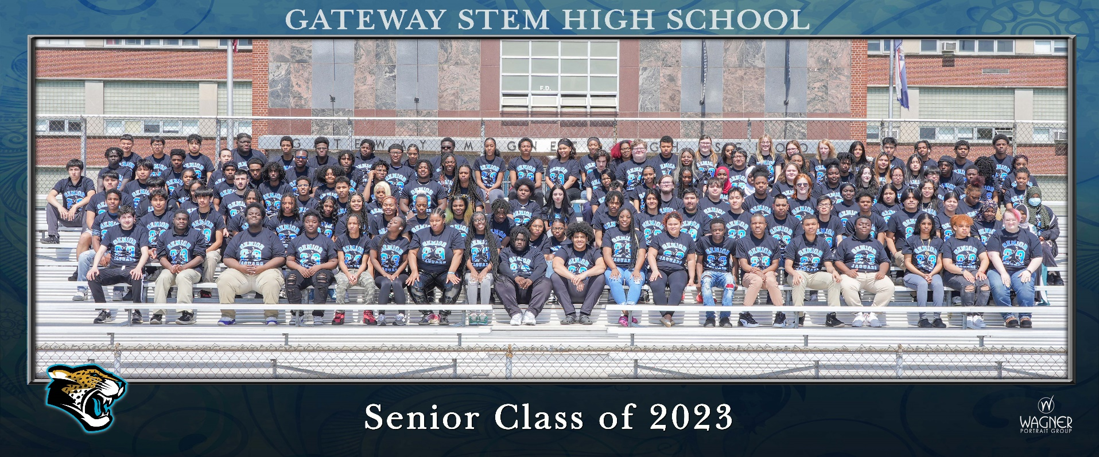
Class of 2023

Slide 2

Agenda
Overview
Line up
Walk Through
Ticket Distribution
Field Day

Slide 3
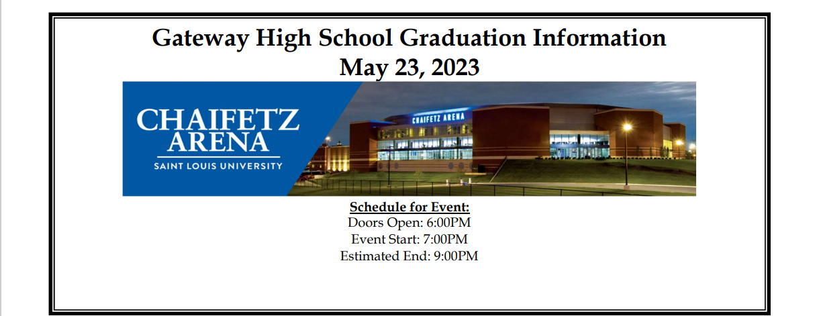

Slide 4
Get There
Arrival: Graduates should arrive no later than 6:00 p.m. to get lined up. Gates open at 5:30 p.m.
Graduates Enter through Gate A on the NW side of the Venue.
PARKING: Parking is FREE for all guests in the Olive/Compton Garage on Compton Avenue.
Golf Cart Shuttles will be available.
Guests Enter through Gates A, B or C.

Slide 5
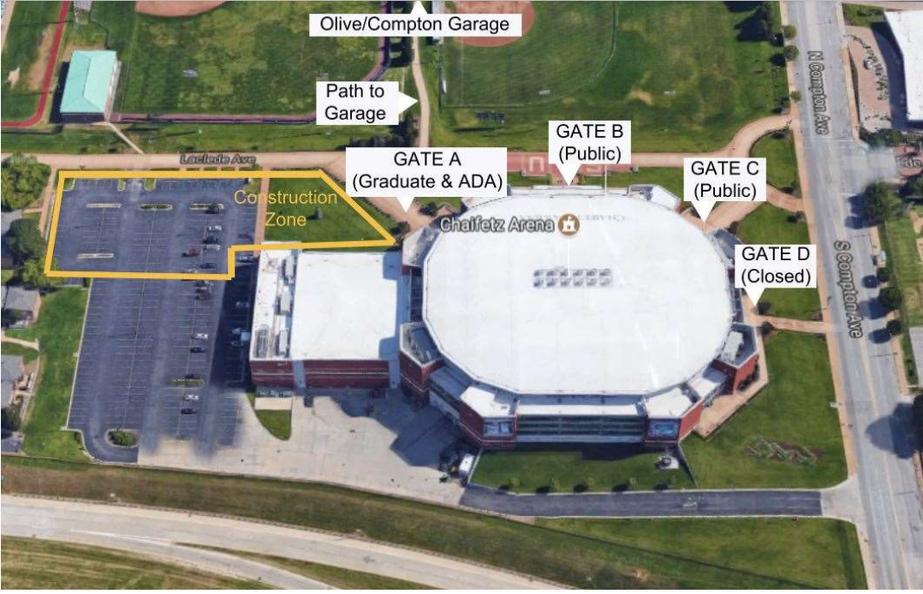

Slide 6
Be on Time
This is very important. We have agreed to strict rules for keeping to our agreed upon time frame. Doors OPEN AT 6:00 p.m. Doors CLOSE AT 9 p.m.
The graduation starts at 7, therefore all graduates should arrive no later than 6. Please make sure your family is at the venue on time.
It is at least a 3 minute walk from the parking garage to the venue.

Slide 7
Prohibited Items
No Outside Food or Drink
No Noise Makers (including air horns, whistles, bells, etc.)
No Balloons
No Confetti
No Silly String
No Wrapped or Bagged Gifts
No Weapons (including mace and pocketknives)

Slide 8
Concessions
Concession Stand open on Concourse by Gate B
Cashless- Credit or Debit Card Only
No Alcohol

Slide 9
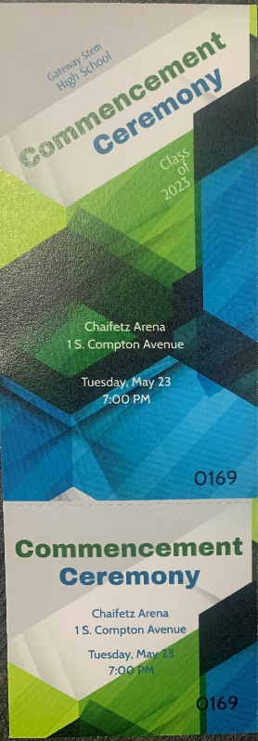
Graduation Ticket
6 Tickets each

Slide 10
Items to Bring
NAME SLIP – This is what you give to the proctor (reader) who will be calling names on the field.
Stole
Optional Medals and/or Cords
Cap
Do not bring bags or other items. These cannot be stored.

Slide 11
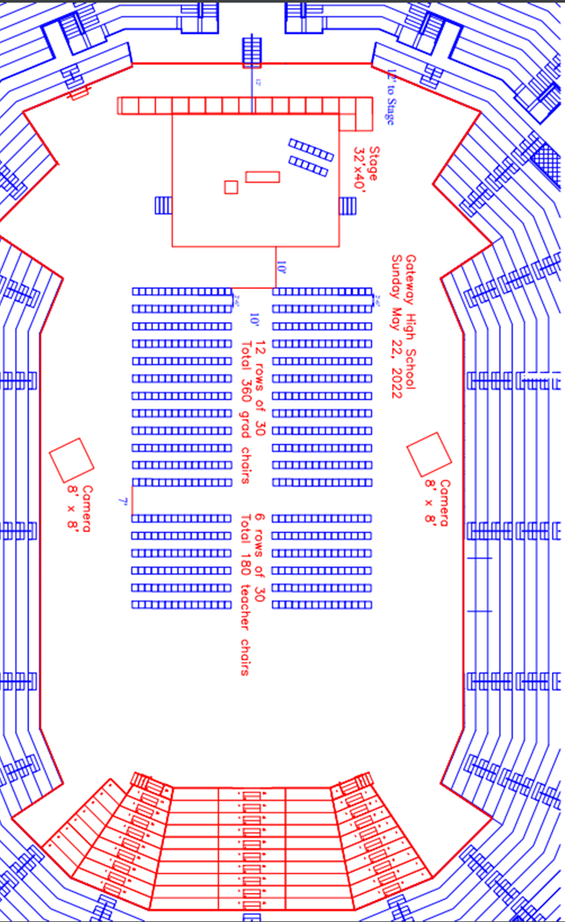
Event Map

Slide 12
Order of Event
Processional
Welcome
National Anthem
Recognitions/Speeches
Awarding of Diplomas
Turning of Tassles
Recessional

Slide 13

Schematic of Your Part

Slide 14
Proctor
Col. Ditlevson
Provide Pronunciation

Slide 15

Handshake
Dr. Phillips
Left over Right
Shake with right
Grab diploma with left

Slide 16
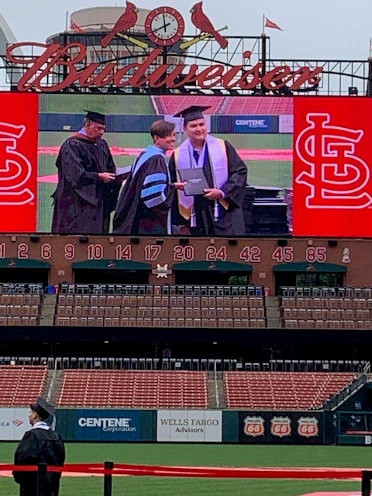
Pictures
1 Handshake/1 Posed
Look at Camera
Hold Handshake
Smile
Show Diploma

Slide 17
Dress
DRESS: Please wear your cap and gown to the ceremony (you will not be able to change at the arena).

Slide 18
Pictures
WE WILL HAVE TWO SETS OF PHOTOGRAPHERS ON THE Floor. NO OTHERS WILL BE ALLOWED. Access to the floor isn’t even possible.
4 x 6 handshake picture is free with your senior dues.
Information to purchase additional pictures is in your program.

Slide 19
Live Stream
LIVE STREAM: Graduation will be live-streamed.

Slide 20
Reminders
Please communicate to your guests:
Everyone must have a ticket, regardless of age
We must exit the venue by 9:00 p.m. You will meet your family outside.

Slide 21
FAQ’s
Will masks be required?
No. Masks are optional but not required.
What can I do if I am not using all my tickets?
Please return unused tickets to the main office for fellow students who need extras! THANK YOU!
Can I get more tickets?
We will consider additional ticket requests on a case by case basis for 1 additional ticket per graduate.
Do we have to stay the entire time?
Yes. All graduates must remain until the end of the ceremony.
.One of my guests is in a wheelchair, where will they sit?
ADA seating is available on a first come; first served basis.

Slide 22
FAQ’s
If we keep our young children on our laps, do they need tickets?
Everyone needs a ticket.
Can I decorate my cap?
Yes, but please keep it tasteful!
Can we have refreshments in the stands?
No food or drinks will be permitted into the venue, but a concession stand will be open for purchasing refreshments.
Will signs and balloons be allowed in the stadium?
Balloons, noisemakers, or anything that distracts from the ceremonies will not be allowed.

Slide 23
Diploma Pick Up
Immediately after ceremony
Staging Area where you entered.
Yearbook, vaccination records, letters from politicians, etc.
Final transcripts will be sent in a few weeks

Slide 24
Schedule
Today: Rehearsal 7:00-8:30, Field Day 8:30-2:00, go home.
Wednesday- stay away from Gateway
Thursday- stay away from Gateway
Friday- stay away from Gateway
Saturday- stay away from Gateway
Sunday- stay away from Gateway
Monday- stay away from Gateway
Tuesday- stay away from Gateway…….6:00 p.m. report to Chaifetz Arena!

Slide 25
Questions?

